Slide 1
Conducting Polymers
By Dr. Deepali Kanekar

Slide 2
Conductive polymer
Polymer (plastic, elastomers and fibres) at start consider as insulators due to their intrinsic property of C—C covalent bond. (σ = 10⁻⁷ to 10 ⁻¹⁸ S/Cm)
Examples, PE and PVC used as insulating material.
Under certain circumstances it can behave as conductors (σ = 10³ to 10⁷ S/Cm)

Slide 3
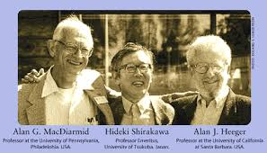
Discovery of conductivity in organic material (polyacetylene) by Shirakawa et. al received Nobel Prize in 2000.

Slide 4
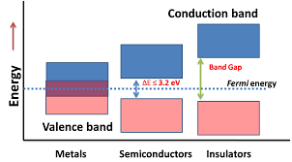
Conductivity increases with decrease in band gap (facilitates easy promotion of electron from HOMO (Highest Occupied Molecular Orbital) or Valence band to LUMO(Lowest Unoccupied Molecular Orbital) or conduction band.)

Slide 5
Metals have zero band gap, whereas insulator have large band gap (3 – 4 eV).
In case of semiconductors Band gap is < 3.2 eV.
low conductivity in polymers with Band gap > 2 eV have been obtained.
However, It is possible to obtain band gad in the range of 0.5 to 1 eV through careful designing of polymer structure.
Conductivity related with free moving electron thus introduction of conjugation in polymer structure help to hop electron throughout the polymer backbone. For this polymer has to disturbed by oxidation or reduction called doping.

Slide 6
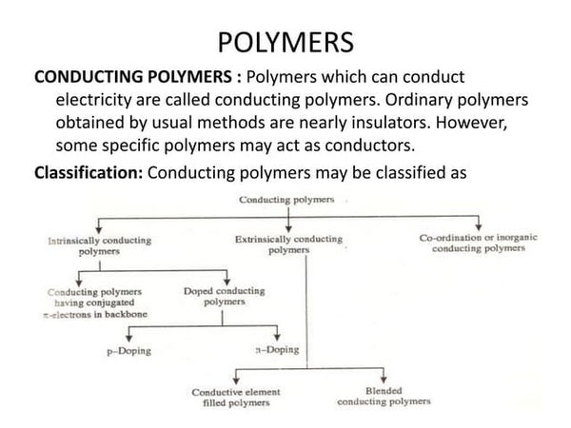
Classification

Slide 7
TYPES OF CONDUCTING POLYMERS:
Intrinsically conducting polymer (ICP)
Doped conducting polymer (DCP)
Extrinsically conducting polymer (ECP)
Co-ordination conducting polymer (CCP) (Inorganic polymer)

Slide 8
ICP
The possess conjugated π- electrons backbone.
When such polymer subjected to electric field, these electrons get excited and move through (hopping)polymeric material.
The orbitals of conjugated π- electrons overlapped on the backbone which form Valence and conduction band distributed over entire surface of polymer.
Appropriate proportion of conjugation makes polymer to conduct the electricity efficiently.
E.g. Polyacetylene, Polyaniline, polypyrrole, polythiophene.

Slide 9
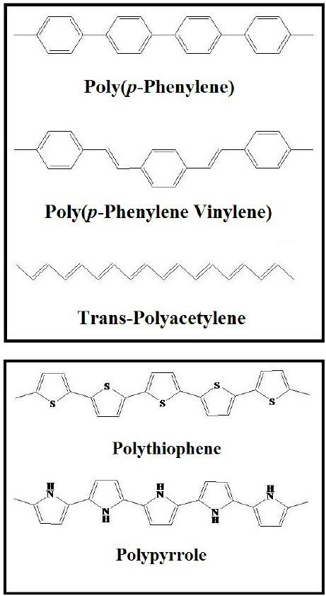
Examples of electrically conducting polymers (ICP):

Slide 10
DCP
These are prepared by exposure of charge transfer agents either in gas or liquid phase.
Compared to plane ICP, these have low I.P. and high E. A.
ICP can be more conductive by creating +ve and –ve charge on its backbone by oxidation or reduction.
This technique called as doping. It has two types
P-doping (oxidation with lewis acid)
N-doping (reduction with lewis base)

Slide 11
P-doping-
In this technique, ICP oxidized with lewis acid creates +ve charge on backbone of polymer.
Thus, Lewis acid is called p-dopant.
Eg. I_{2 ,}Br_{2 ,} AsF_{6 ,} PF₆
Polymer + Lewis Acid P-doping (oxidative coupling)
Notes:
iodine charge transfer complexes the I2 acts as a Lewis acid. This is possible since iodine is a Row 3+ element and so is capable of forming hypervalent complexes on reaction with a Lewis base.

Slide 12
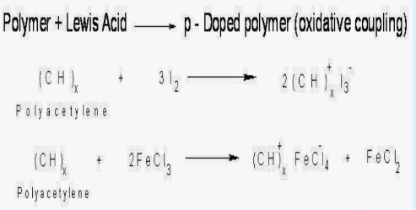

Slide 13
2. N-doping
In this, reduction of ICP with lewis base forms negative charge on backbone of ICP.
Eg. Li, Na, Cu, Napthyl amine

Slide 14
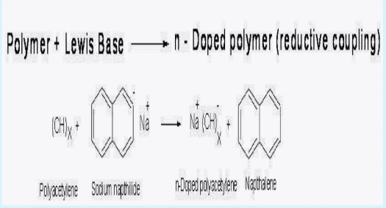

Slide 15
ECP
CP which posses conductivity due to externally added ingredient in them.
Conductive element filled polymer –
1. Resin or polymer filled with conducting element. Eg. Carbon black, metallic fibres, metal oxides
2. Polymer holds metallic element (act as binder)
Possess reasonably high conductivity.
Properties- Strong, light weight, easy to mould and low cost.

Slide 16
2. Blended CP
Blend of normal polymer with conducting polymer.
Blending done either by physical change or in certain cases chemical change.
They possess good mechanical properties.

Slide 17
Co-ordination CP/Inorganic CP
Inorganic in nature
In which the complex involved in transfer of charge is combined with polymer, and metal atom combined with polydenated ligands.

Slide 18
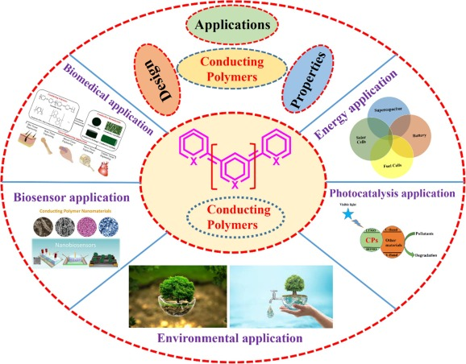
Applications of CP:

